Slide 1

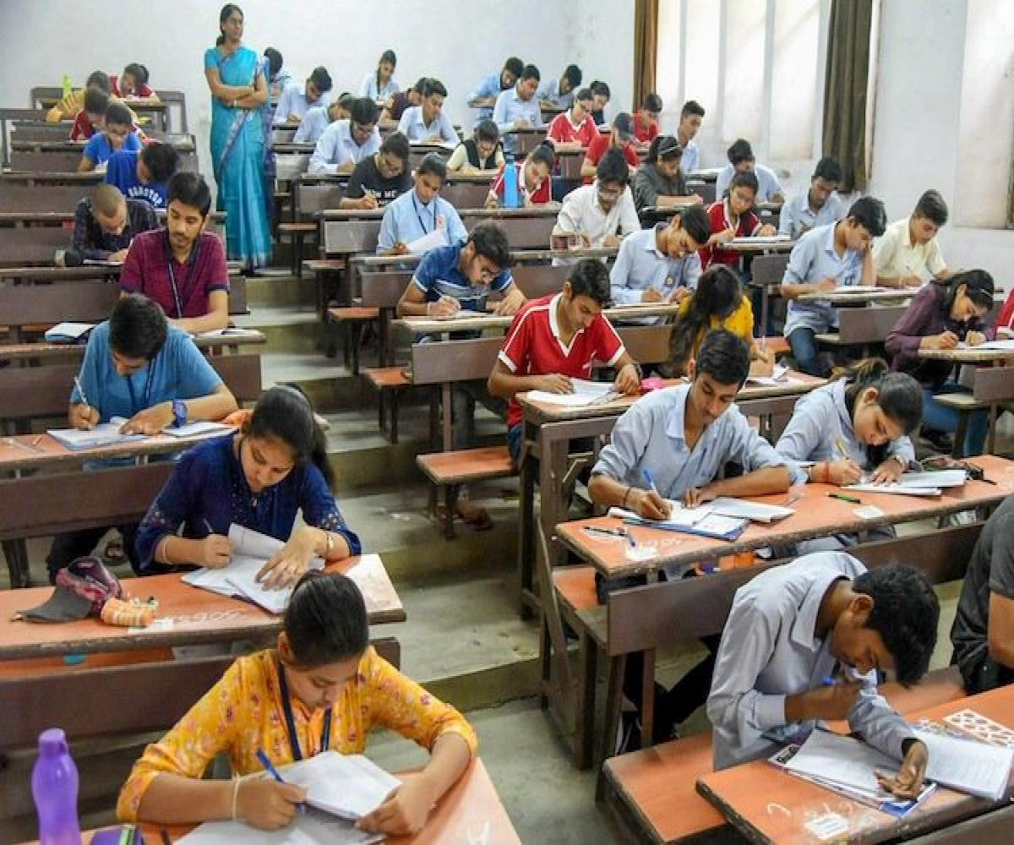
Exam Center Assignment
Group 8

Slide 2
Presented By
Saranya Munigolla
Shwetha Julappayyanapalya Parashurama reddy
Lakshmi Durga Pippara
Senthamil Selvi A.P.
Geetanjali Sambana
Yalavarthi Sravya
Under the Guidance
Sikander Sir

Slide 3
CONTENTS
Introduction
Problem statement
Scope of the project
DFD Level 0 and Level 1
Functional Requirements
Non-Functional Requirements
Software and Hardware Requirements
Conclusion

Slide 4
INTRODUCTION
AIM:
The aim of this project is to gather, analyse and give an in-depth insight into the complete exam centre assignment application
Purpose:
The purpose of this project is to show the requirements for the exam centre assignment application, in which candidate will be assigned their exam centre based on their exam information

Slide 5
PROBLEM STATEMENT
Application is to be developed to assign exam centres to candidates and generate candidate hall tickets by system with information

Slide 6
SCOPE OF THE PROJECT
The scope of the project is to create the development of an exam centre assignment application which takes the candidate information and adds into the database

Slide 7
FUNCTIONAL REQUIREMENTS
Functional requirements are the services provided by the system to its end users
FUNCTIONS:
insertCandidateData()
insertExamData()
printHallTicket()
ProcessCandidateData()
writetofile()

Slide 8
NON FUNCTIONAL REQUIREMENTS
A non-functional requirements defines the quality attribute of a software system
A non-functional requirement is essential to ensure the usability
Makefile
Valgrind tool
Cunit

Slide 9
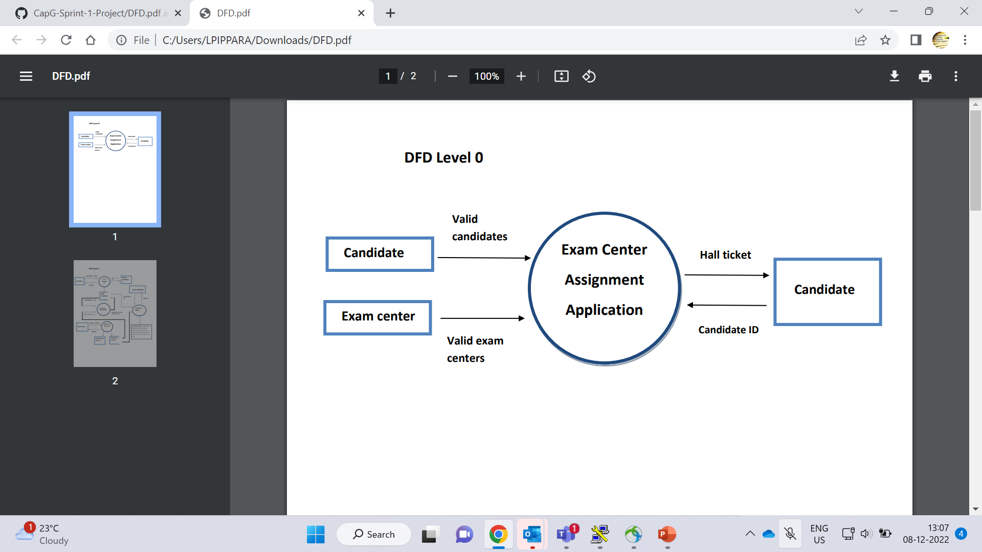
DFD LEVEL 0

Slide 10
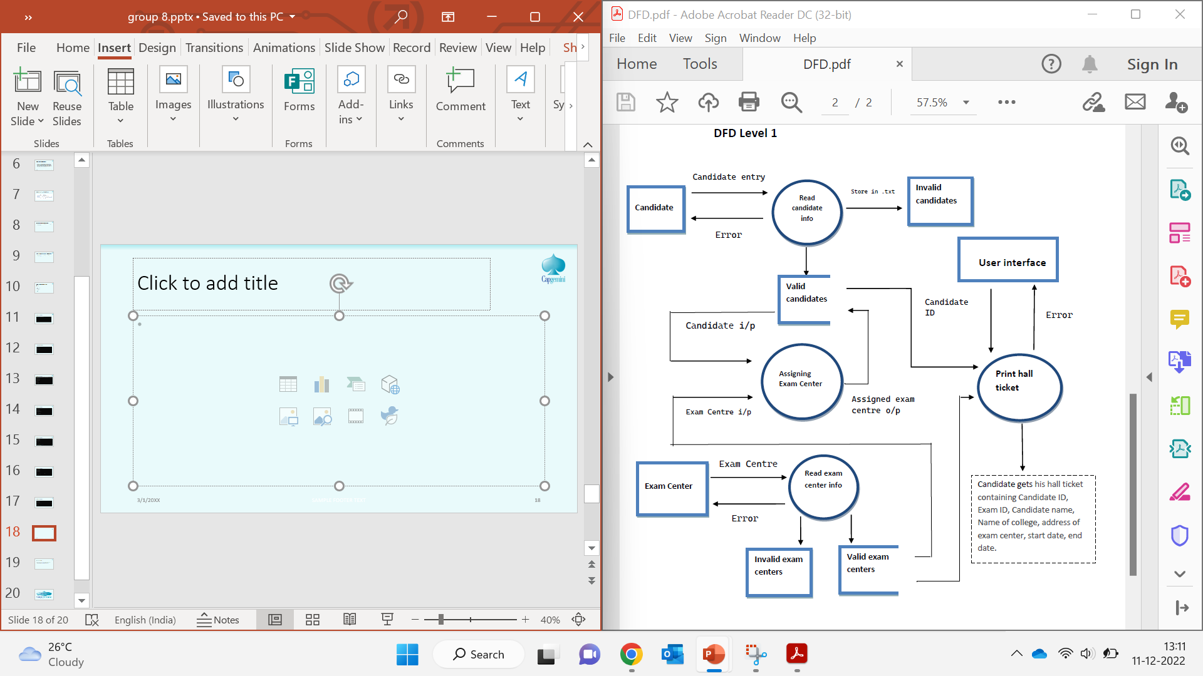
DFD LEVEL 1

Slide 11
SYSTEM REQUIREMENTS
Tools to be used:
System Programming
pthread library
Linux
C programming
C File Handling
Valgrind
make

Slide 12
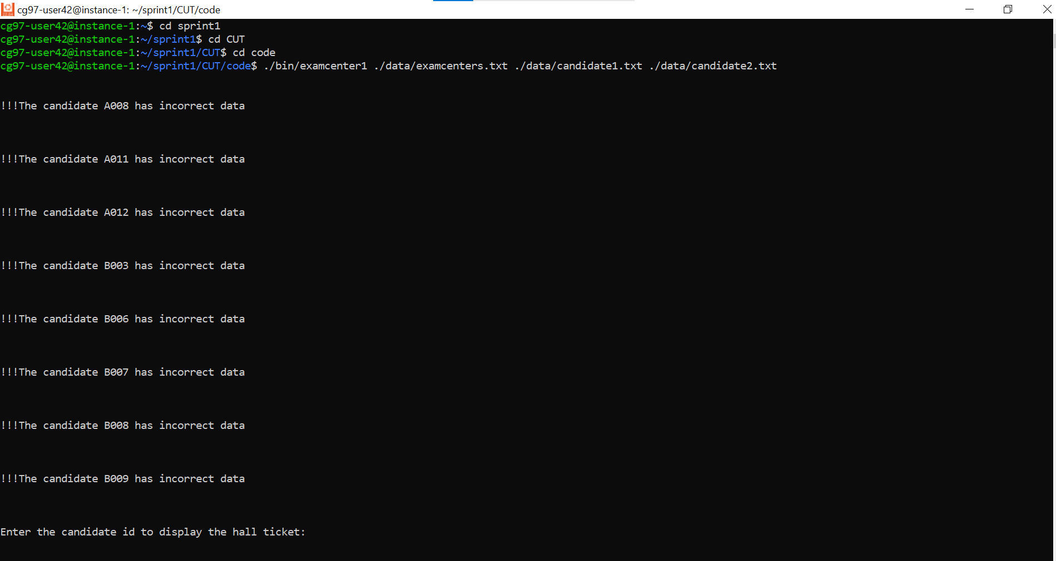
IMPLEMENTATION

Slide 13
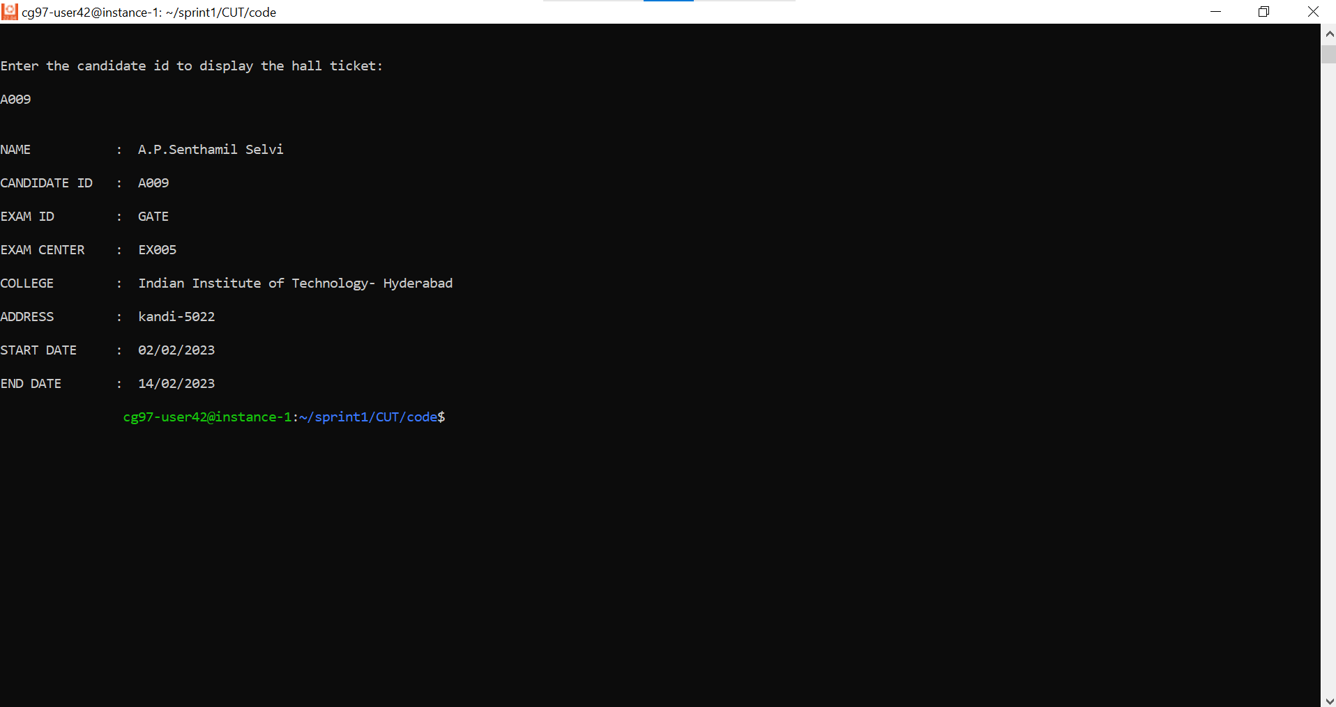
IMPLEMENTATION

Slide 14
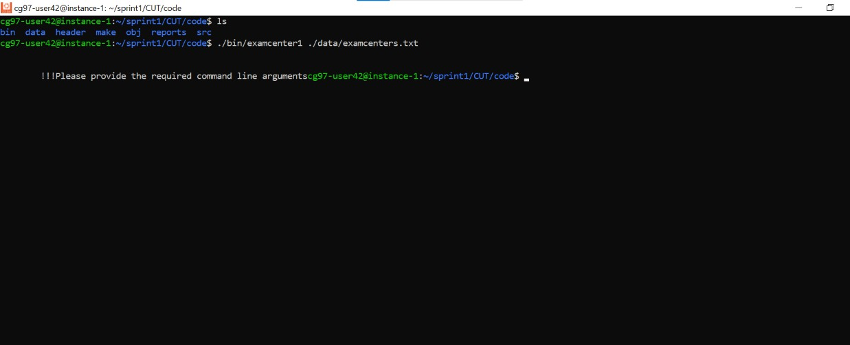
IMPLEMENTATION

Slide 15
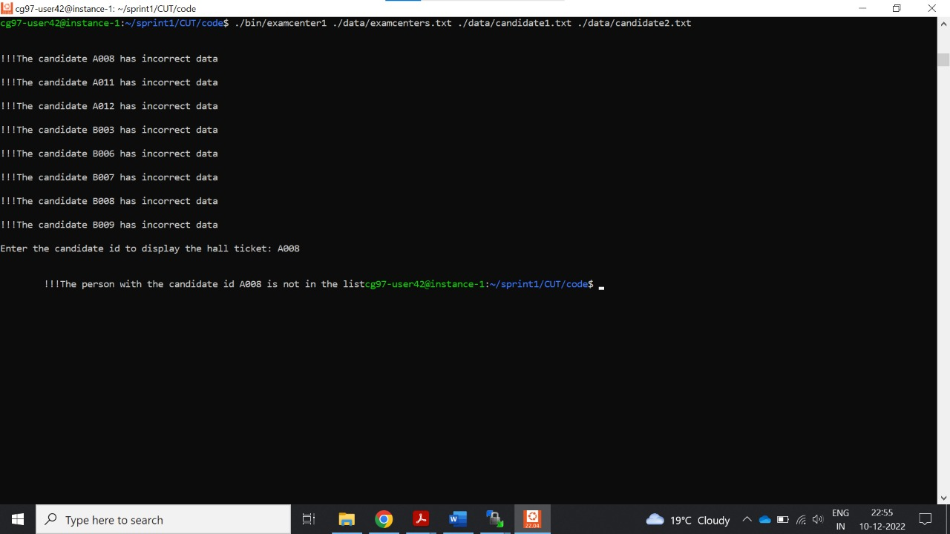
IMPLEMENTATION

Slide 16
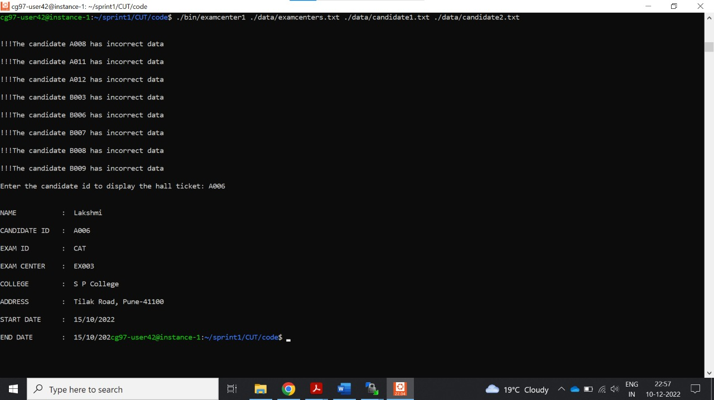
IMPLEMENTATION

Slide 17

IMPLEMENTATION

Slide 18

IMPLEMENTATION

Slide 19

IMPLEMENTATION

Slide 20

IMPLEMENTATION

Slide 21
CONCLUSION
We can conclude that our project will print the hall ticket of the candidate with all the details and also exam center of the given candidate ID

Slide 22
THANK YOU

